Slide 1

Can you pass this test?

Slide 2
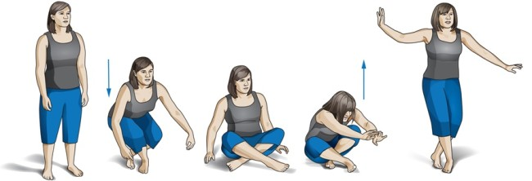
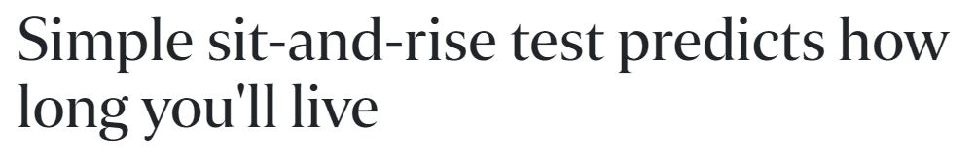
Can you sit and rise without using your hand?
The Straits Times : https://www.straitstimes.com/singapore/health/simple-sit-and-rise-test-predicts-how-long-youll-live

Slide 3
01
INTRODUCTION

Slide 4
Main Muscle Groups Used
Sit-and-Stand
Squats
Legs
Thighs
Back Muscles
Legs
Thighs
Back Muscles
Medium : https://medium.com/@leanwaistwarrior/why-squats-are-the-king-of-all-exercises-4621119900b0

Slide 5
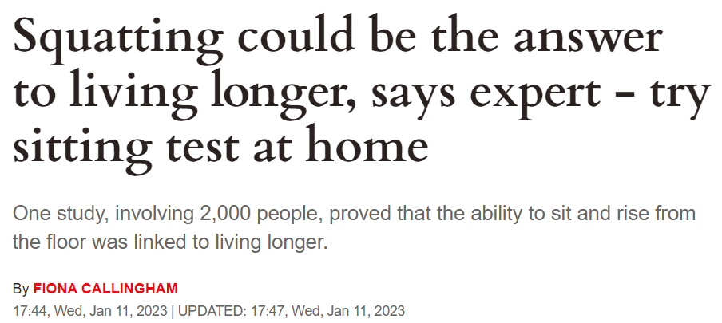
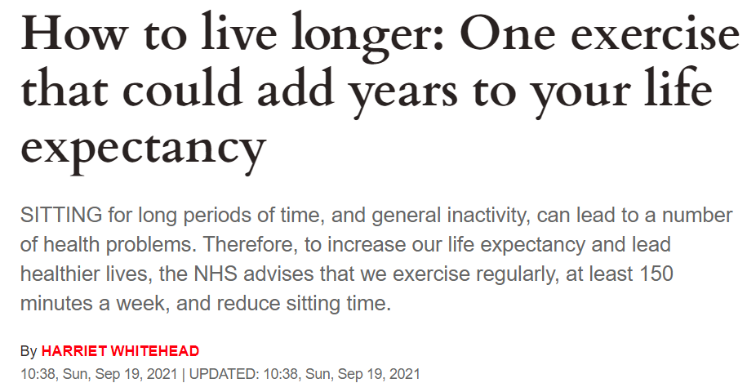
Squat - King of All Exercises
VENUS
Repeated Mentions of Same topic over time
Backed by European Journal of Preventive Cardiology
UK News Channel - Express.co :https://www.express.co.uk/life-style/health/1720005/how-to-live-longer-squatting-sitting-rising-test

Slide 6
How do people learn squat?
Personal Trainer
Fitness App
Pro: Customised Training Plan, Varied Benchmarking
Con: Expensive
Pro: General Self Management Strategies
Con: Some are free but does not have specialised feature for squats
Learn from Online Video
Pro: Free of Charge
Con: No feedback

Slide 7


Popular Videos to Squat Properly
> 10 millions
views

Slide 8
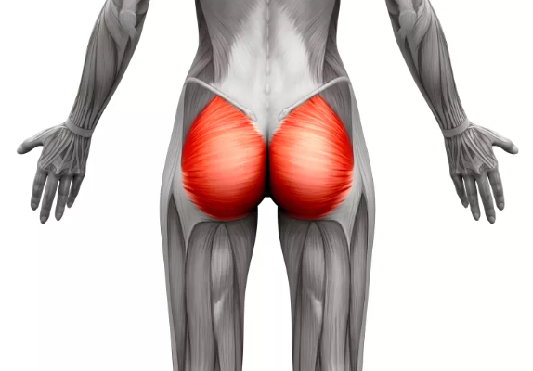
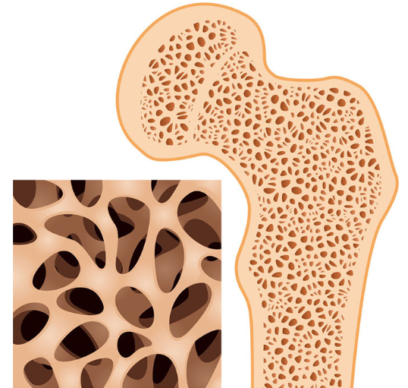

The BENEFITS of Squats
Strengthen Core Muscle Group
Boost Bone Mineral Density
Sustain Body Functionality
Glutes and quadriceps
Adds strengths to your skeleton, mainly lower body
The ability of sit-and-rise may predict your chance of dying early
WebMD :https://www.webmd.com/fitness-exercise/health-benefits-of-squats#:~:text=It%20adds%20strength%20to%20your,process%20and%20limber%20you%20up.

Slide 9
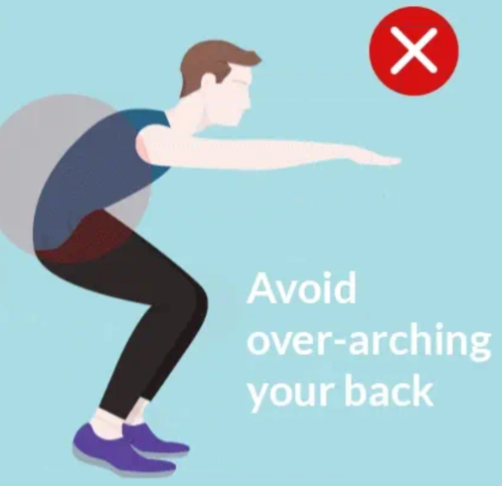
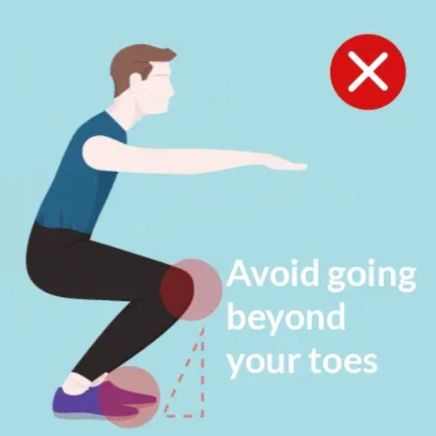
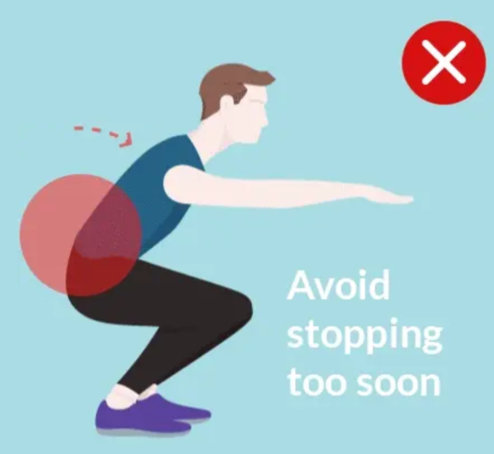
The CONs of doing WRONG SQUATS
Back Injury
Knee Injury
Does not Strengthen muscle

Slide 10
02
PROBLEM STATEMENT

Slide 11
The project aims to…
Empower individuals to improve their health and fitness by
(i) learn how to do a correct squats independently;
(ii) assess their squat count;
(iii) improve their squat form.

Slide 12
03
DATA COLLECTION/CLEANING

Slide 13
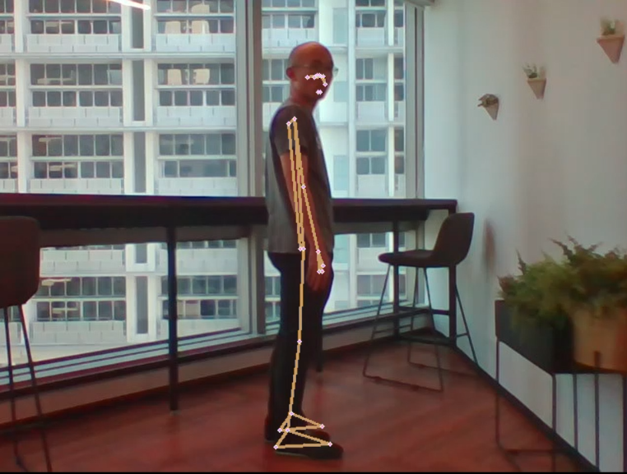
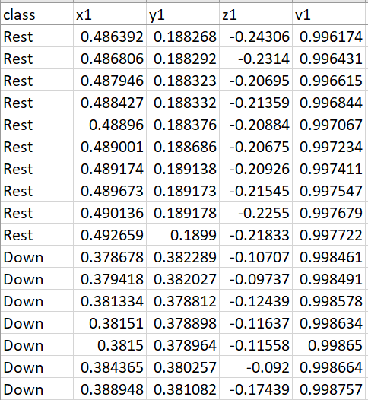
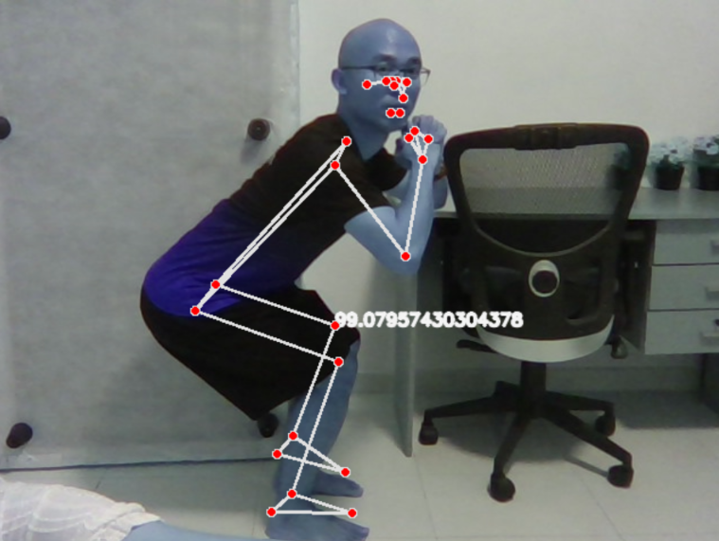
Data Collection
Define Class for machine
Position for Camera
Translate to coordinates
Rest
MARS
Down

Slide 14
Data Collection vs Data Cleaning
Trade-Off

Slide 15
04
EXPLORATORY DATA ANALYSIS (EDA)

Slide 16
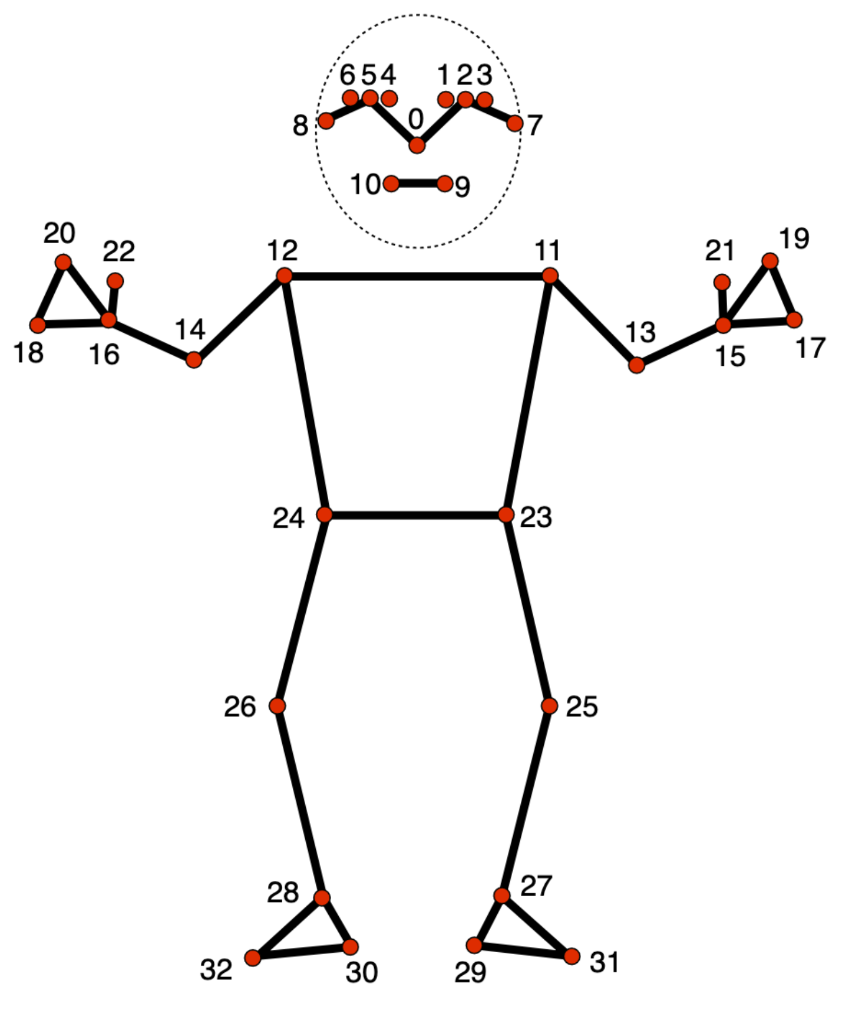
Pre-Trained
Joints Detection Model
33
4
133
Joints detection points
Data collection per points
Columns of Coordinates Data & Class

Slide 17
4 Coordinates / Joints
X
Y
Z
V
Horizontal Coordinates
Vertical Coordinates
Depth Coordinates
How well computer could see the coordinate

Slide 18
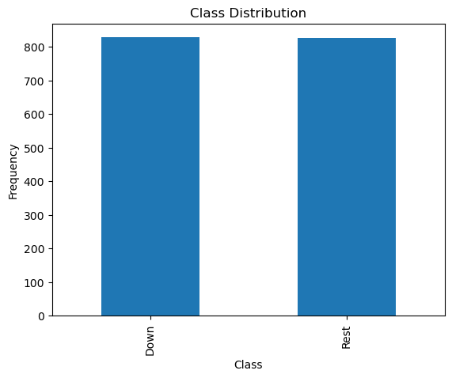
Even Class to Avoid Machine Bias
1600
6
6
Rows of Coordinates
Rest States
Down States

Slide 19
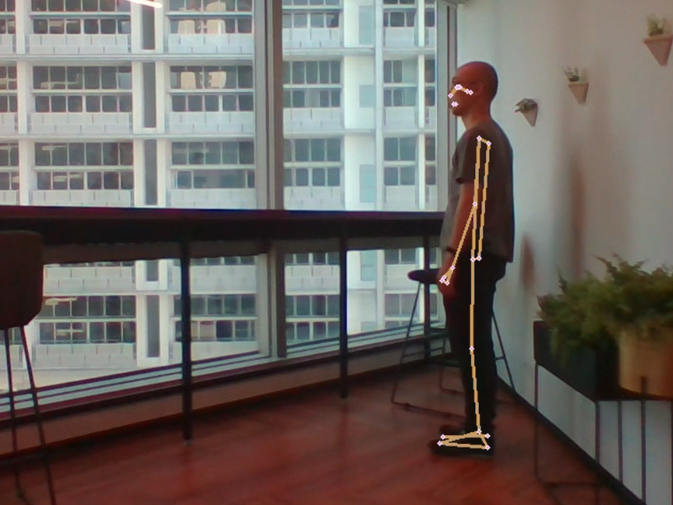
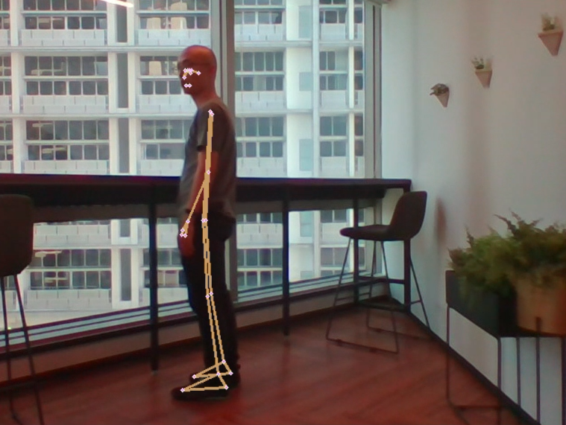
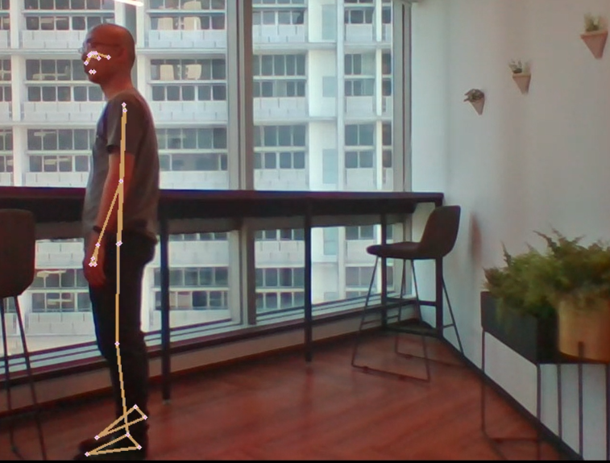
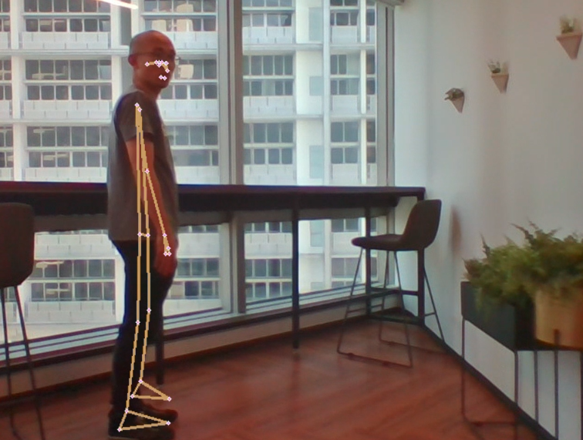
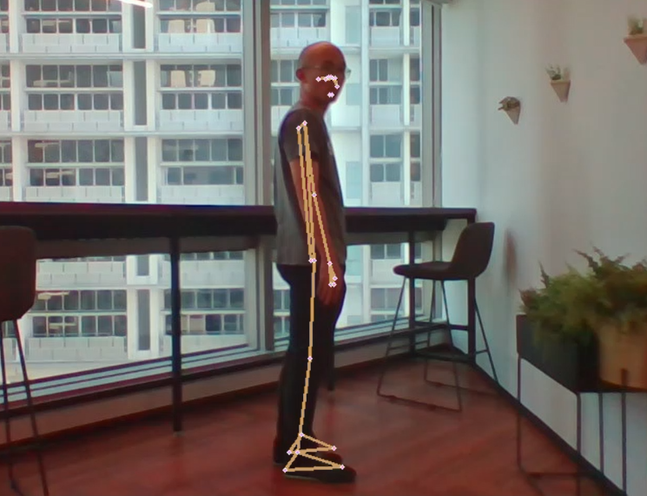
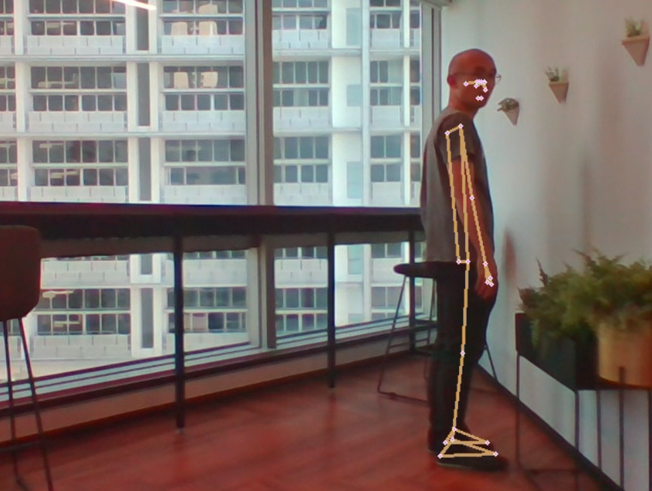
Computer Vision - ‘Rest’ State

Slide 20
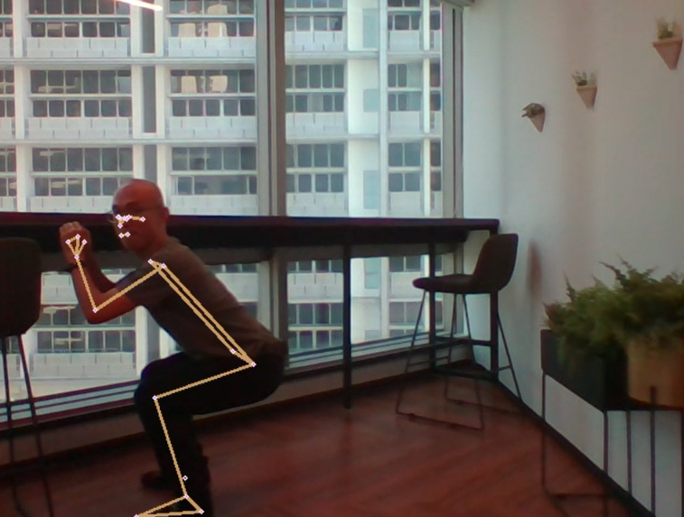
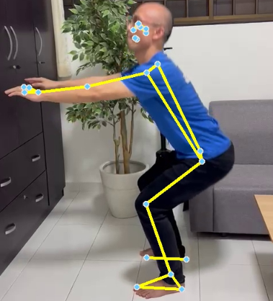
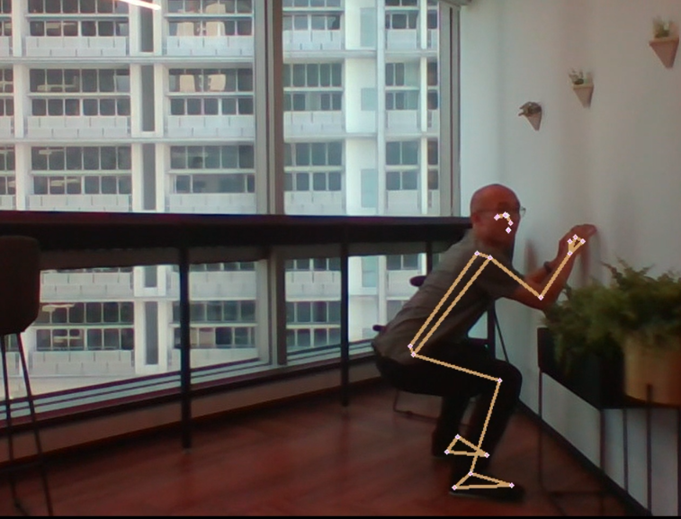
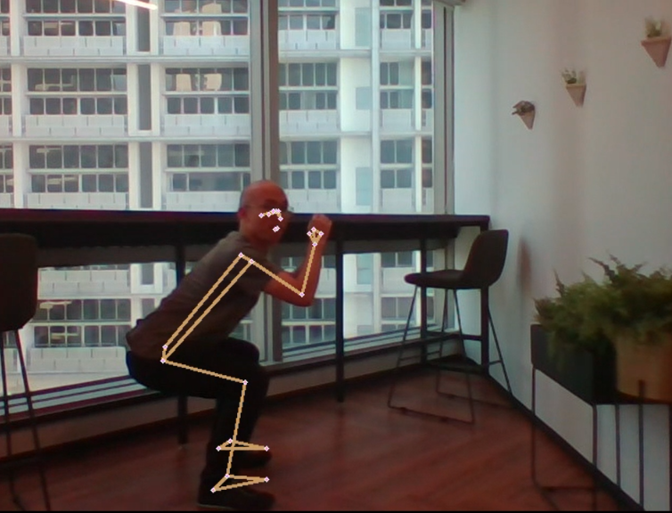
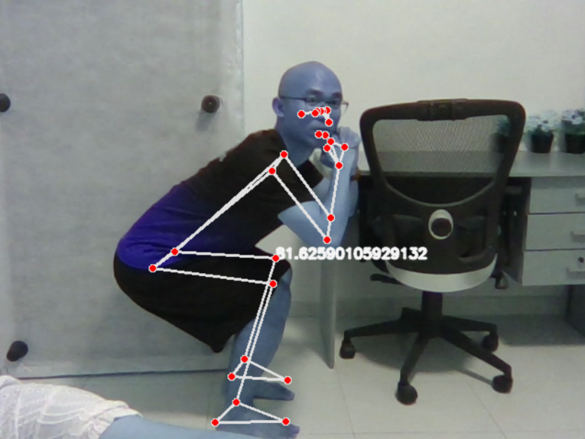
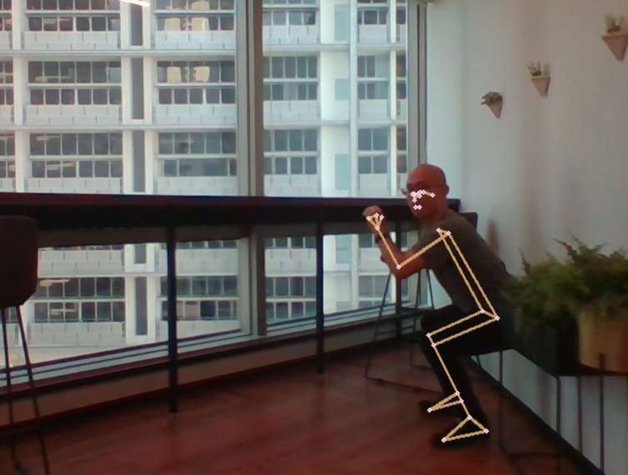
Computer Vision - ‘Down’ State

Slide 21
05
MODELLING

Slide 22
Modelling Workflow
Model Used Hyperparameters Tuning Metrics
Random Forest Classifier
(RF)
n_estimators
max_depth
samples_leaf
Train Accuracy
Logistic
Regression
(LR)
penalty
C
max_iter
Test Accuracy
XGBoost Classifier
(XGB)
learning_rate
n_estimators
sample_leaf
Train F1 Score
AdaBoost Classifier
(ABC)
n_estimators
learning_rate
estimator
Test F1 Score
Notes:
After the preprocessing steps, the data is ready for the model to train on.
We deployed 4 models, namely..
Hyperparameters tuning were carried on all 4 models for evaluation
Lastly the Ensemble Voting Classifier was deployed with 4 previously trained models to make prediction on the dataset

Slide 23
MODEL SCORE
 | Train Accuracy | Test Accuracy | Train F1 Score | Test F1 Score
Null Model (Baseline) | 0.5 | 0.5 | 0.5 | 0.5
Random Forest Classifier | 0.9983 | 0.9960 | 1.0 | 0.9957
Logistic Regression | 0.9983 | 0.9960 | 1.0 | 0.9958
XGBoost Classifier | 0.9965 | 0.9960 | 1.0 | 0.9957
AdaBoost Classifier | 1.0 | 0.9980 | 1.0 | 0.9958

Slide 24
06
STREAMLIT DEMO

Slide 25
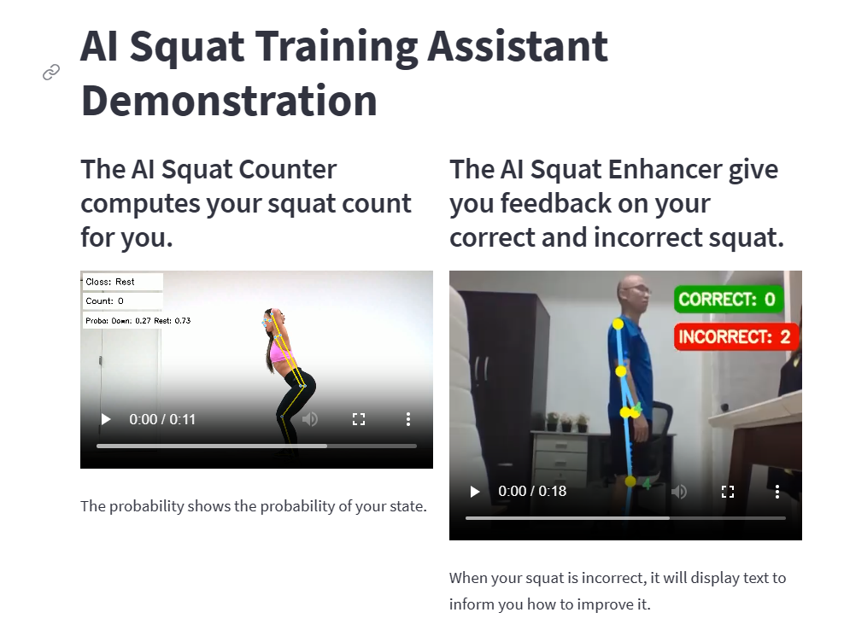
1 Slide of Counter
MARS
SATURN
Venus is the second planet from the Sun
Despite being red, Mars is actually a cold place
Saturn is a gas giant and has several rings

Slide 26
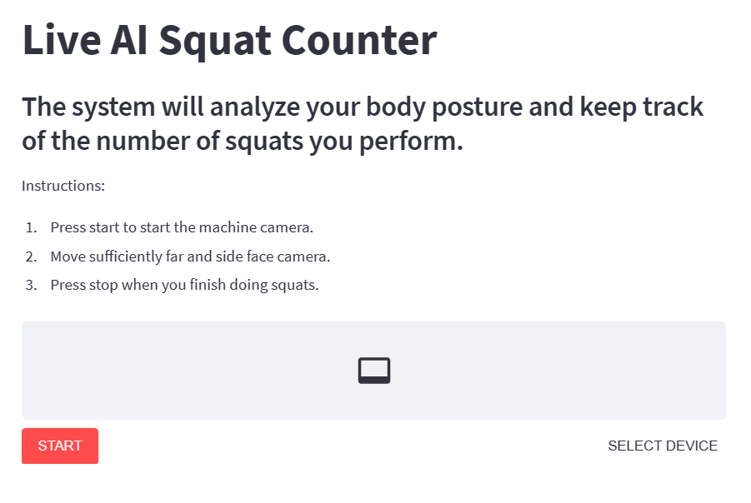
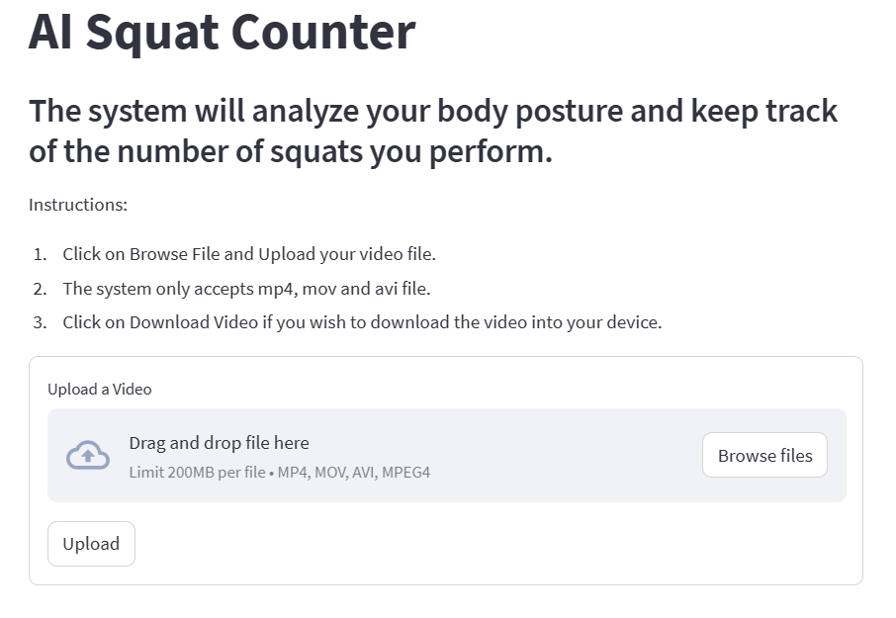
Squat Counter
Live Version
Mobile
Venus is the second planet from the Sun

Slide 27
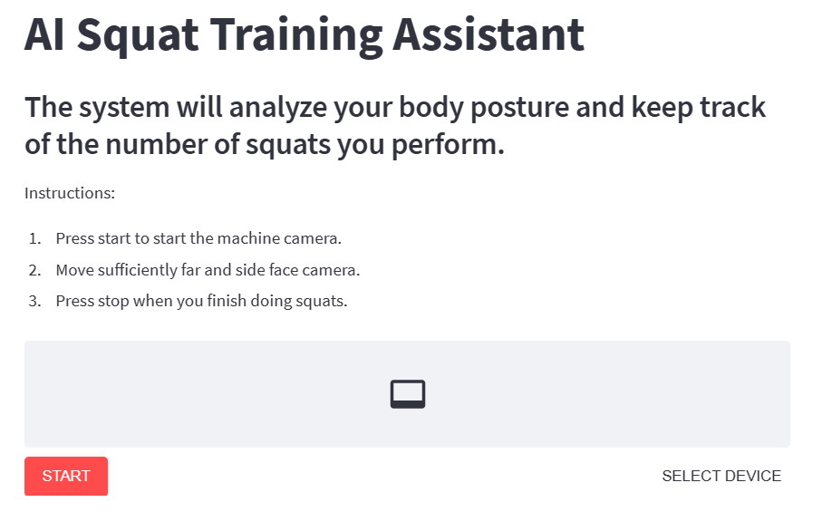
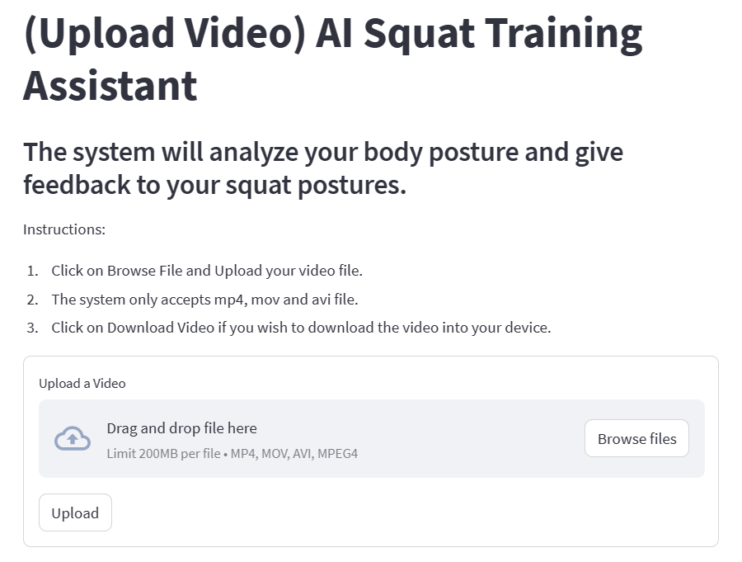
Squat Counter
Live Version
Mobile

Slide 28
07
MODEL EVALUATION

Slide 29
Streamlit Features ⇔ Problem Statement
Instant Feedback
Prescriptive Feedback
Mobility
Assess Squat
Count
Improve Squat Form
Learn Correct Squat independently
Venus has a beautiful name
It’s the biggest planet of them

Slide 30
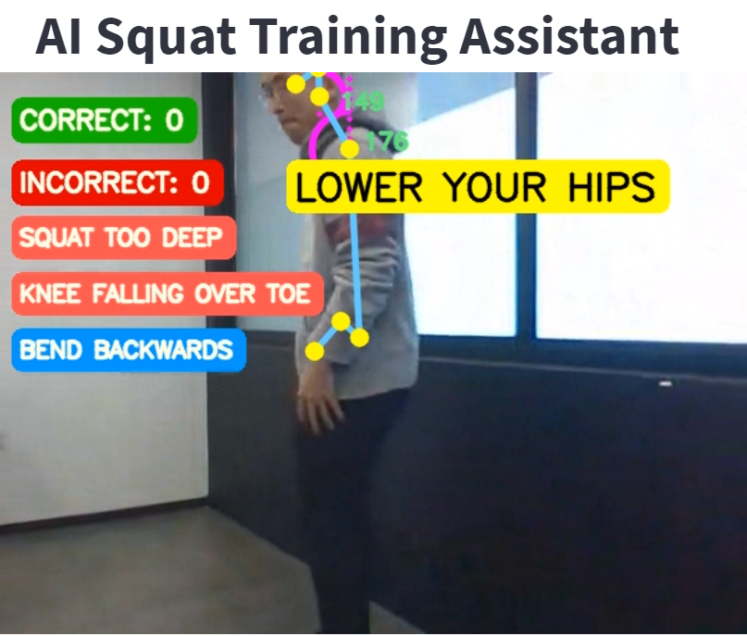
4 Prescriptive Messages
Knee Over Toes
Lower Your Hips
Bend Backwards
Bend Forward

Slide 31
Prescriptive Messages ⇔ Wrong Squat
Bend Forward/Backwards
Knee Over Toes
Lower Your Hips

Slide 32

Summary of Product Features
 | Product Features
 | Accuracy | Instant Feedback | Prescriptive Feedback | Mobility
Live Counter
Live Enhancer
Upload Counter
Upload Enhancer

Slide 33
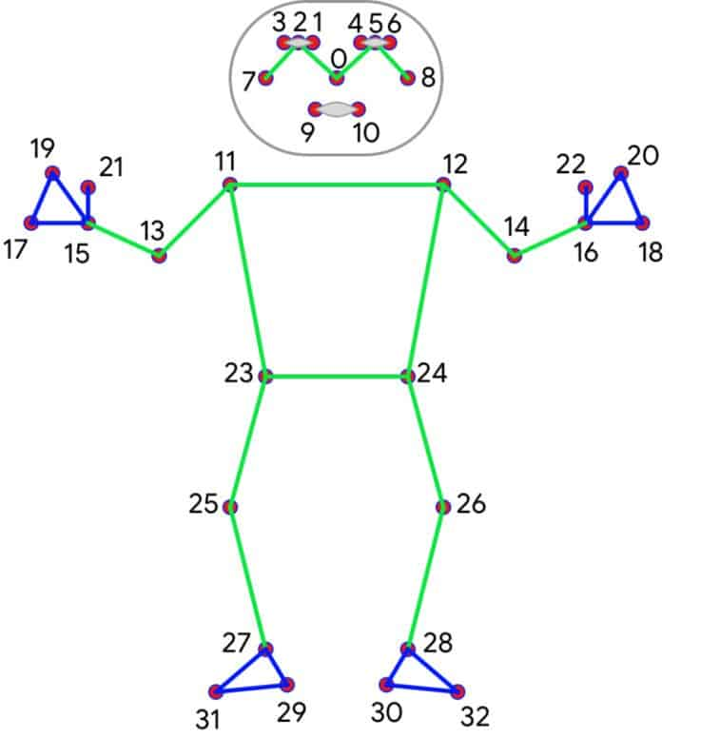
Future Work
Other Exercises
Sound Effect
Further Training of Model
Sit Up and Deadlifts
When correct squat is performed
Train model with different heights of people

Slide 34
THANK YOU

Slide 35
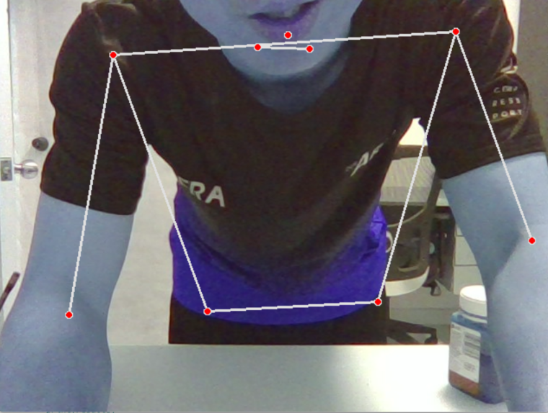
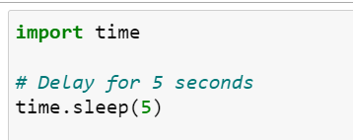
Challenges in Data Collection
Machine collected data instantaneously
Insert a 5 seconds sleep time for me to be in position

Slide 36
Challenges in Data Collection
Challenges
Solutions
Multiple Detection of Bodies will confuse Machine
Clear the areas before data collecting
Machine collects the data when I was about to off the program
Data Cleaning

